Slide 1

Topic Modelling on Reviews
DSI12
Shaun Kwek

Slide 2

Before booking accomodations...
Customer’s considerations:
Price & Location
Reviews
Reading Reviews is very time consuming
People are not interested to read every single review
Business problem:
Able to retain potential customer on the platform, but failure to seal the deal.

Slide 3

Problem Statement
To ease the process in reading reviews, by providing categories for customers to choose.
Data Science Approach:
NLP - Topic Modelling, using Latent Dirichlet Allocation (LDA)
A process to find the topic from document
Unsupervised learning

Slide 4

Dataset @ first glance (insideairbnb.com)
Monthly compiled reviews from 03 - 11, 2019, in Singapore
Listing ID (apartment ID)
Date of review
Reviewer ID (customer ID)
Comments (reviews)
Total Reviews: 915641 Entries

Slide 5
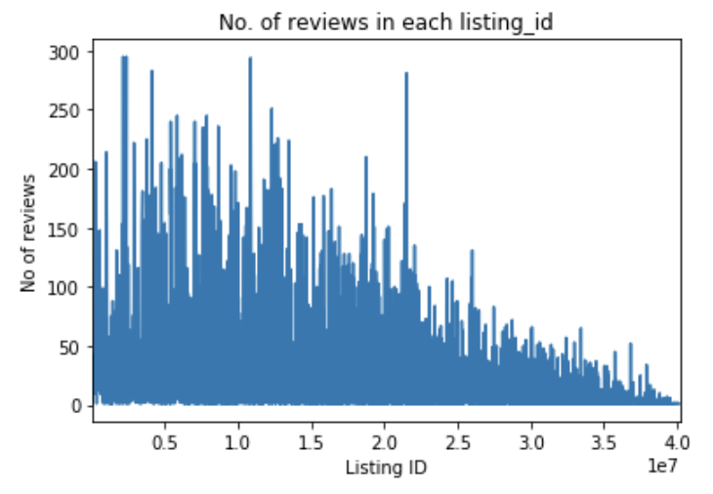

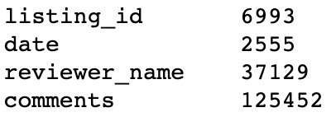
EDA
No. of reviews per listing_id Max: 295, Mean: 18
No. of unique listing_id:
Presence of Chinese characters
Automated message (not an actual review): 2070

Slide 6

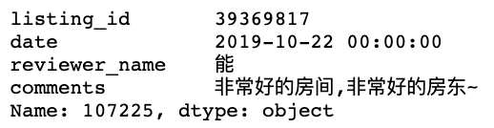
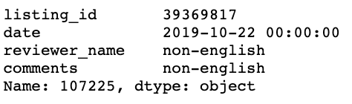
Data cleaning & Pre-processing
Regex, retaining only english words
Checking & removing nulls
Remove duplicates (915641→ 129528)
Remove Stopwords, lower-case
Keeping bi-grams with min 5 occurrence, & threshold of 100
Lamatizing and tokenizing, keeping only nouns
['joyce', 'and', 'her', 'family', 'are', 'incredibly', 'friendly', 'and', 'go', 'above', 'and', 'beyond', 'in', 'making', 'their', 'guests', 'feel', 'welcome', 'the', 'place', 'is', 'constantly', 'kept', 'clean', 'and', 'tidy', 'with', 'comfortable', 'living', 'and', 'dining', 'space', 'it', 'super', 'easy', 'to', 'feel', 'at', 'home', 'here']
['family', 'guest', 'place', 'tidy', 'living', 'dining', 'space']

Slide 7
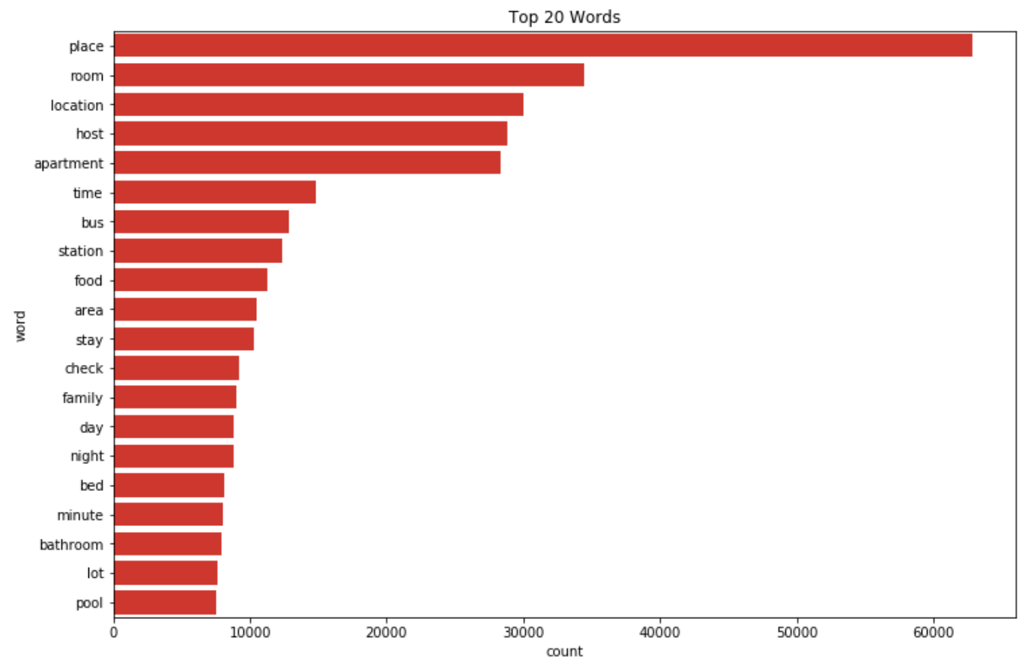
Top 20 words in reviews 03-11, 2019

Slide 8

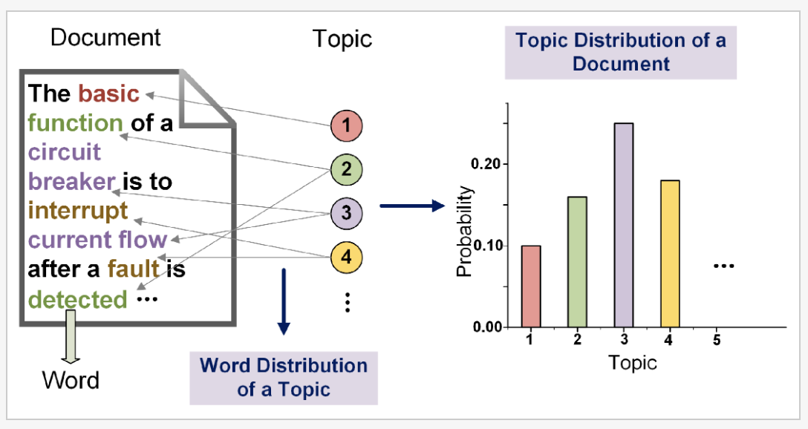
Latent Dirichlet Allocation (LDA)
Notes:
Topic modelling refers to the task of identifying topics that best describes a set of documents. These topics will only emerge during the topic modelling process (therefore called latent). And one popular topic modelling technique is known as Latent Dirichlet Allocation (LDA). Though the name is a mouthful, the concept behind this is very simple. To tell briefly, LDA imagines a fixed set of topics. Each topic represents a set of words. And the goal of LDA is to map all the documents to the topics in a way, such that the words in each document are mostly captured by those imaginary topics. We will systematically go through this method by the end which you will be comfortable enough to use this method on your own. Each document can be described by a distribution of topics and each topic can be described by a distribution of words

Slide 9
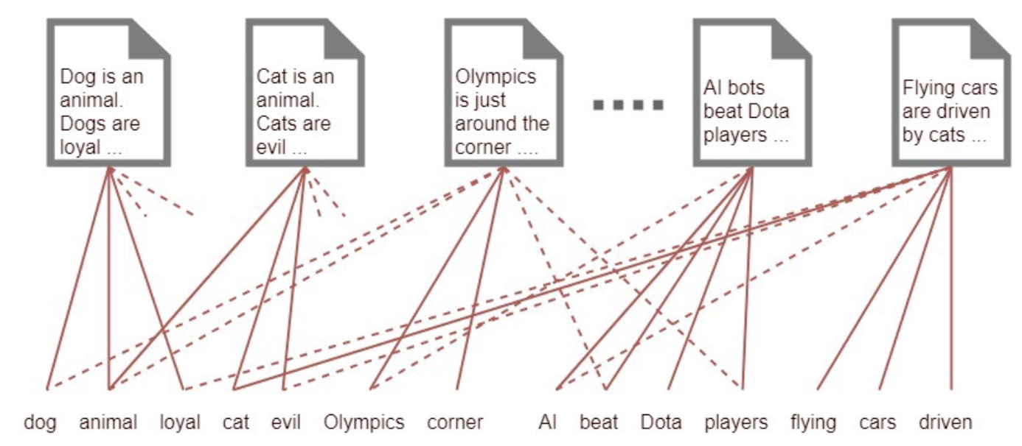
How LDA works?

Slide 10
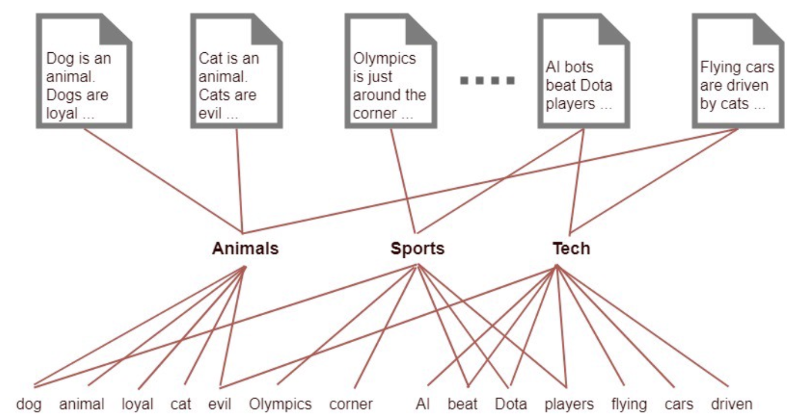
How LDA works?

Slide 11
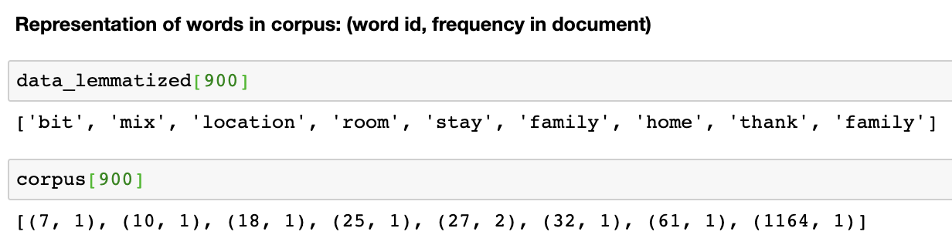
In order to proceed with LDA...
Assumption:
Documents with the same topic, will use similar words
Every document is composed by a mixture of topics
Every word has a probability of belonging to a certain topic
Requirements:
Dictionary
Corpus (word_id, word_frequency)
Number of Topics
Notes:
(word_id, word_frequency). For example, (0, 1) below in the output implies, word id 0 occurs once in the first document.
LDA does not care the order of the words in the document. Usually, LDA use the bag-of-words feature representation to represent a document. It makes sense, because, if I take a document, jumble the words and give it to you, you still can guess what sort of topics are discussed in the document.

Slide 12

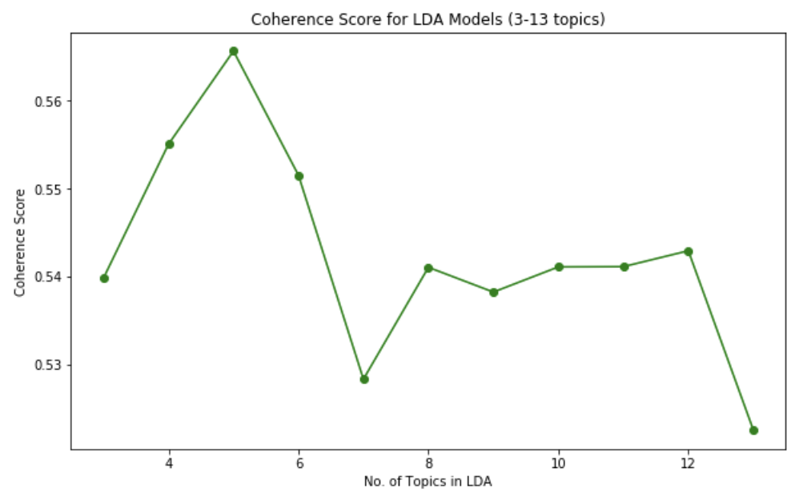
How pick no. of topics?

Slide 13
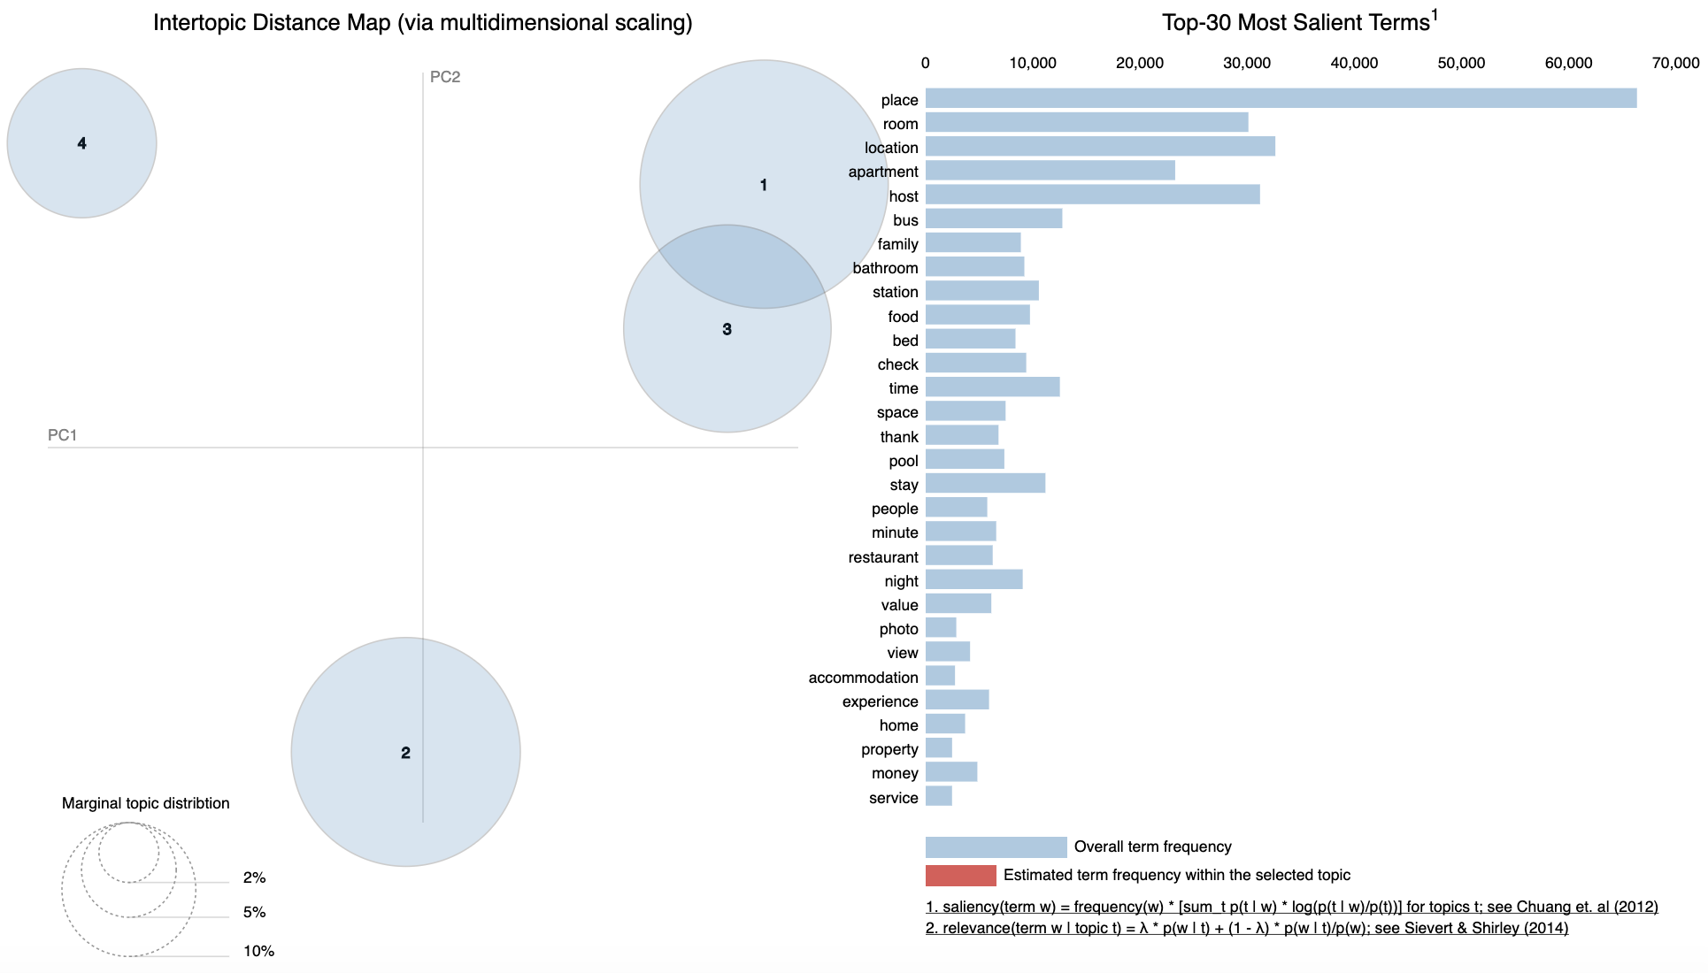

How pick no. of topics (4 Topics) ?

Slide 14
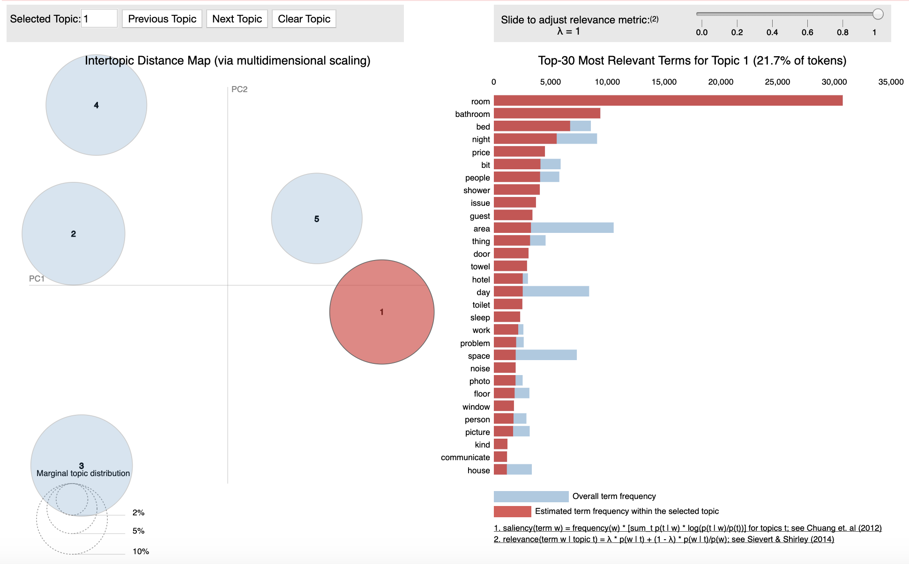

How pick no. of topics (5 Topics)?

Slide 15
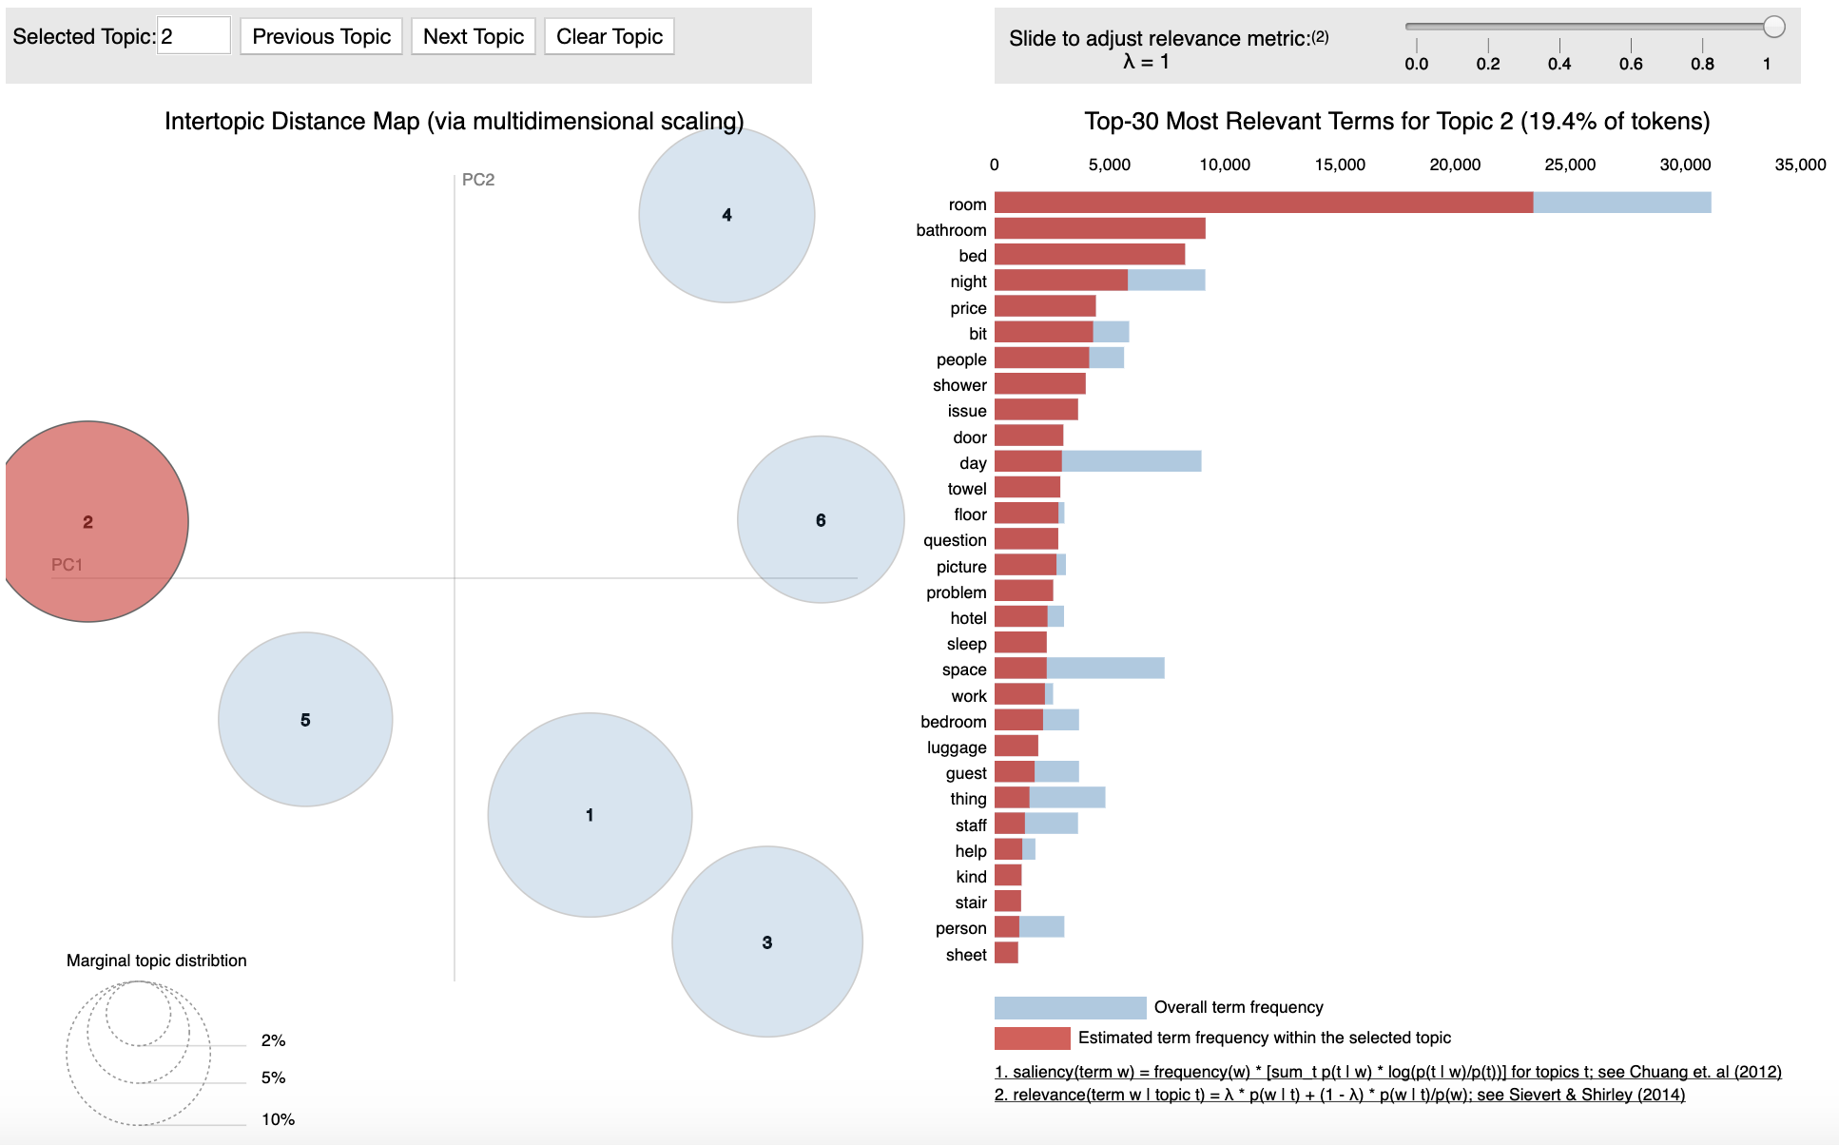
How pick no. of topics (6 Topics)?

Slide 16
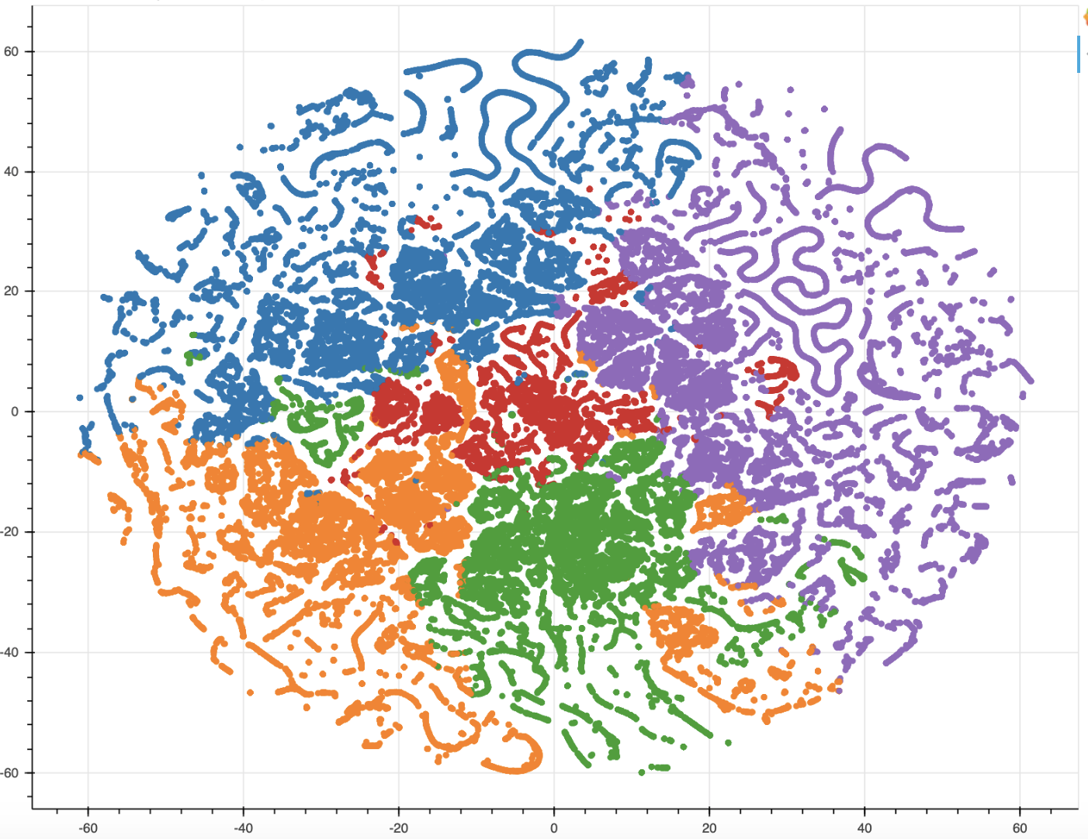
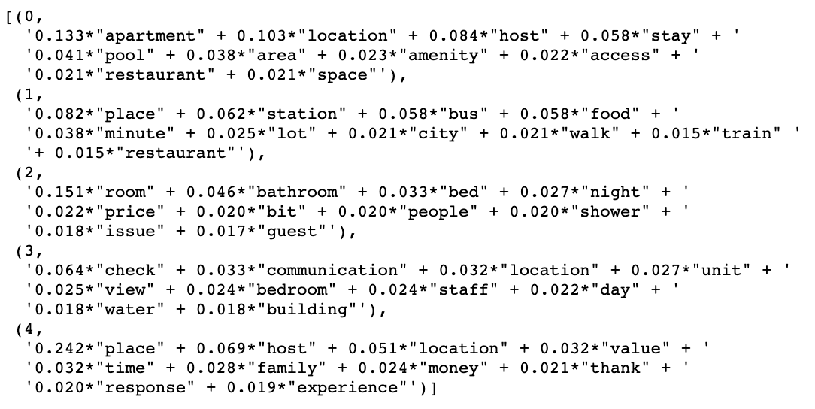
Overview of Topic interaction in Doc.

Slide 17
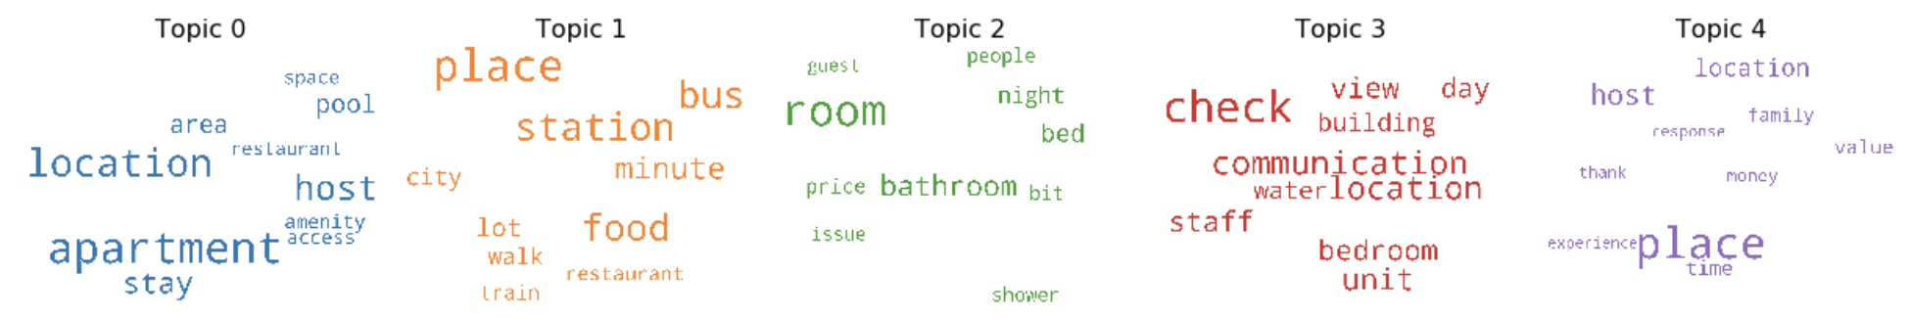
Output of selected LDA model (9 Topics)
5 Topics
Keywords for each topic
Weightage(importance) of each keyword
Need to infer what the topics are
Notes:
You can see the keywords for each topic and the weightage(importance) of each keyword

Slide 18
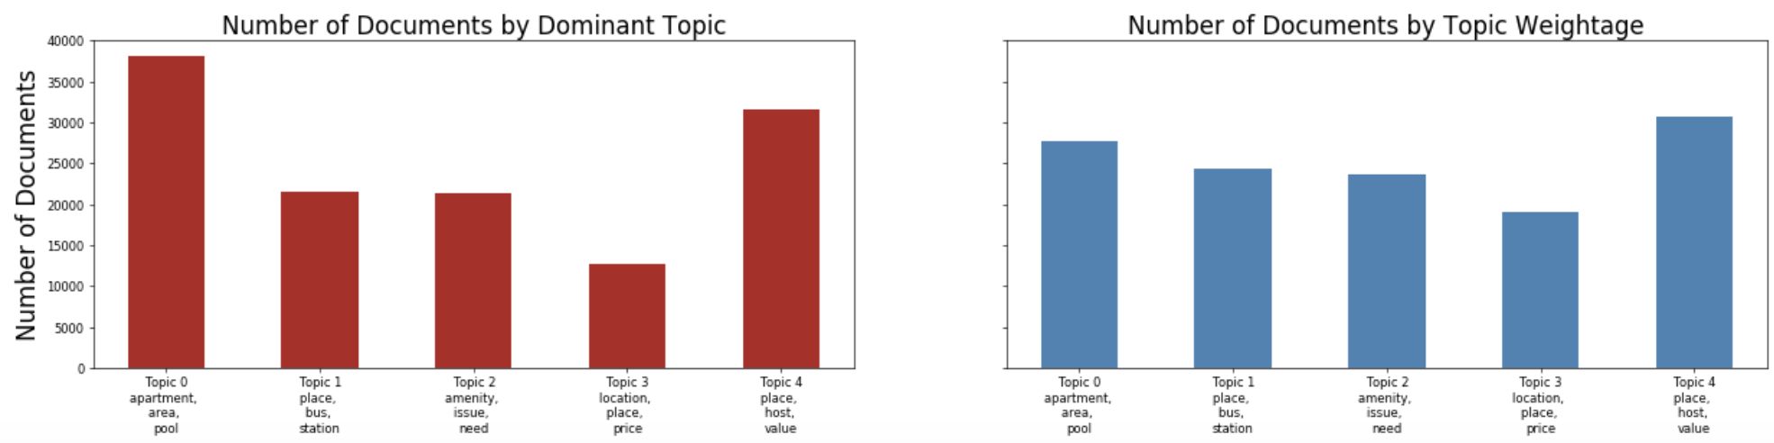
No of Documents by Topics & by Weight

Slide 19

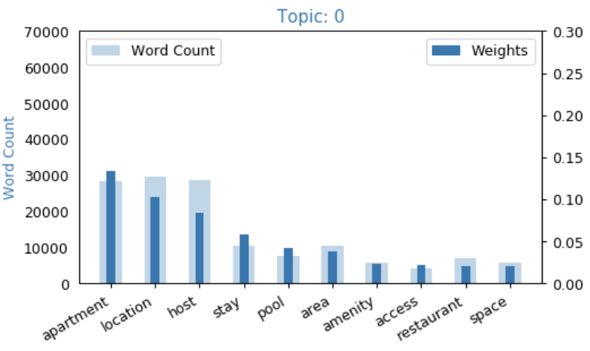
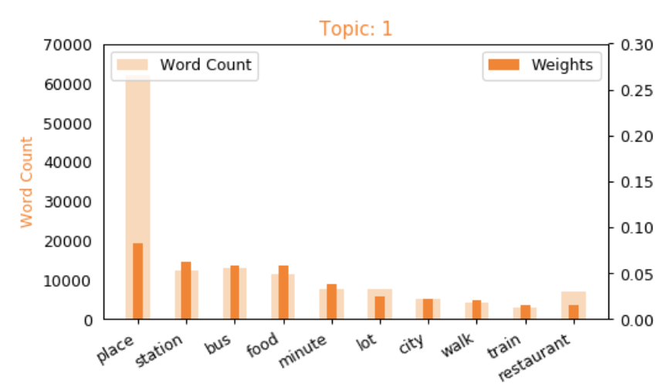
Word Count & Importance of Topic Keywords
Facilities
Accessibility

Slide 20
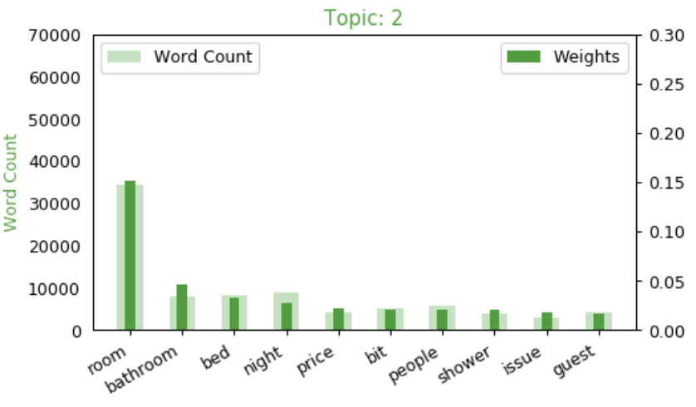
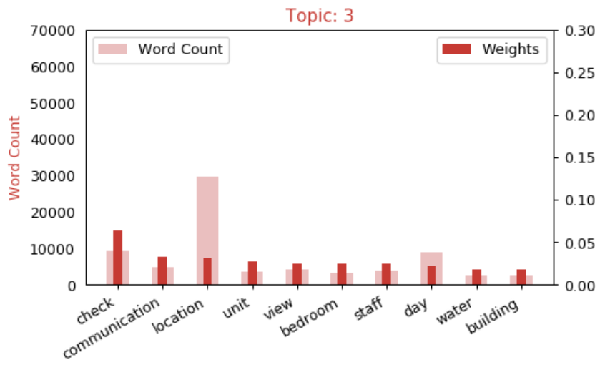
Word Count & Importance of Topic Keywords
Apartment/Room Amenities
Hospitality/Experience

Slide 21
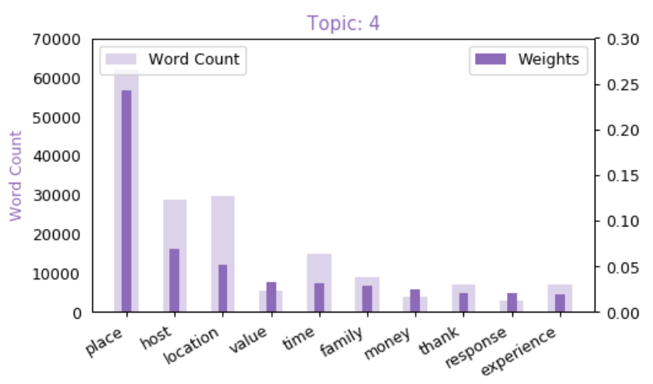
Word Count & Importance of Topic Keywords
Values

Slide 22
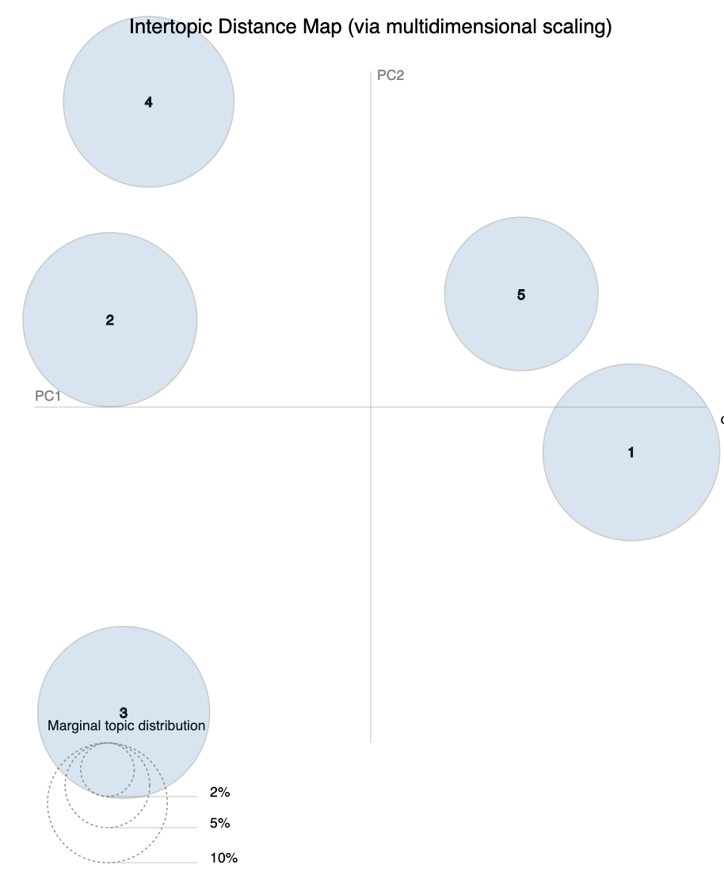
5 Topics in Reviews for customer to select
Facilities
Hospitality/Experience
Values
Apartment/Room Amenities
Accessibility
Notes:
1- Apartment/Room amenities
2- Value
3- Assessibilty/Transportation
4- Facilities
5- Hospitality/Experience

Slide 23

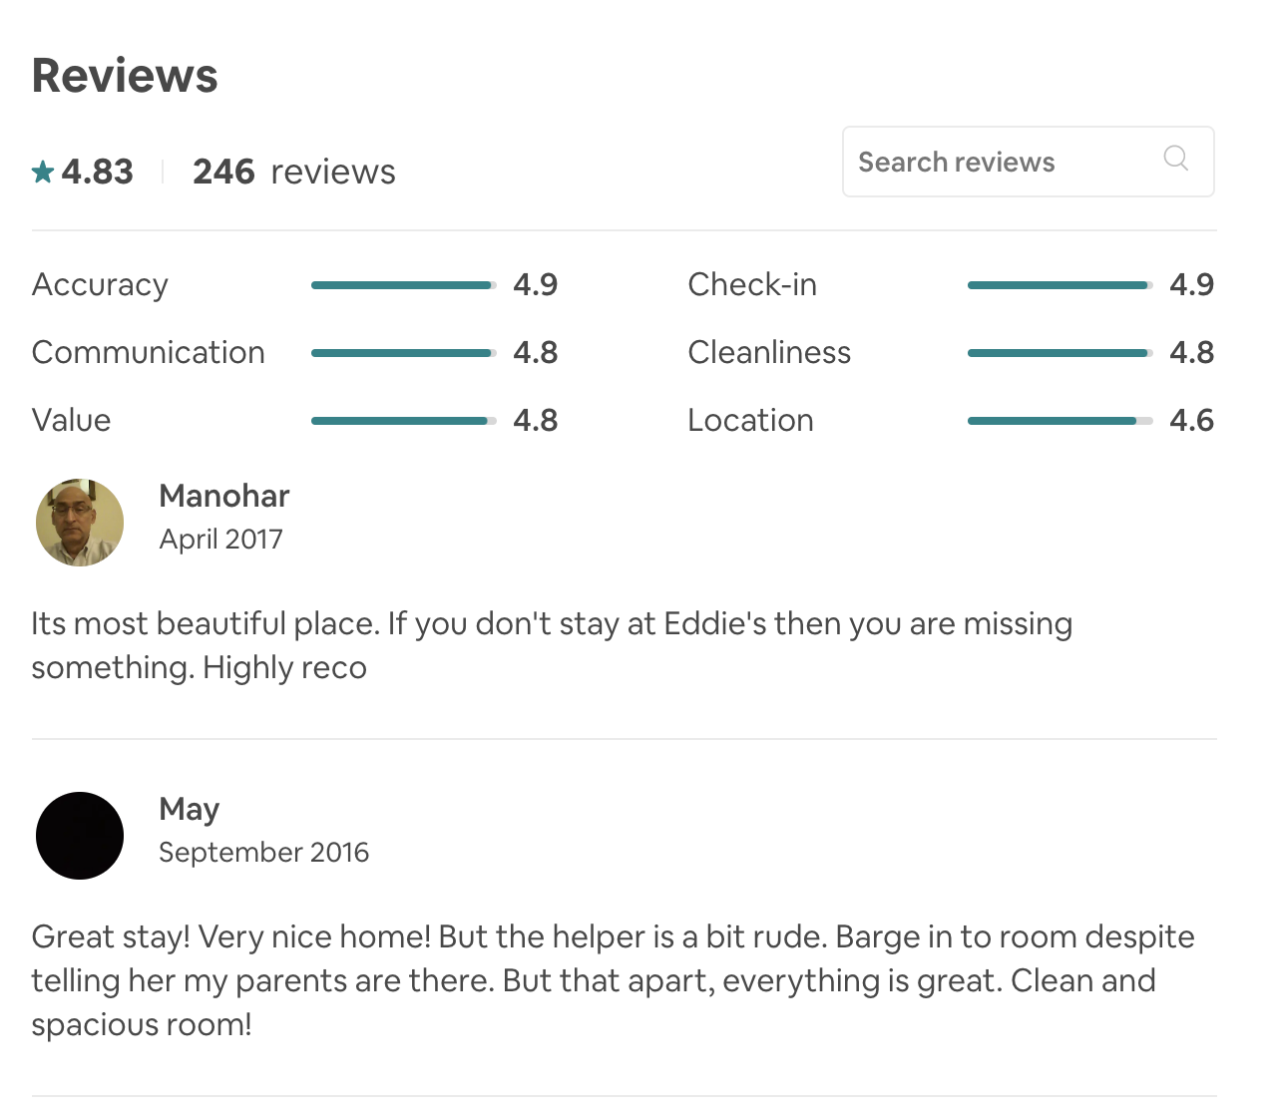
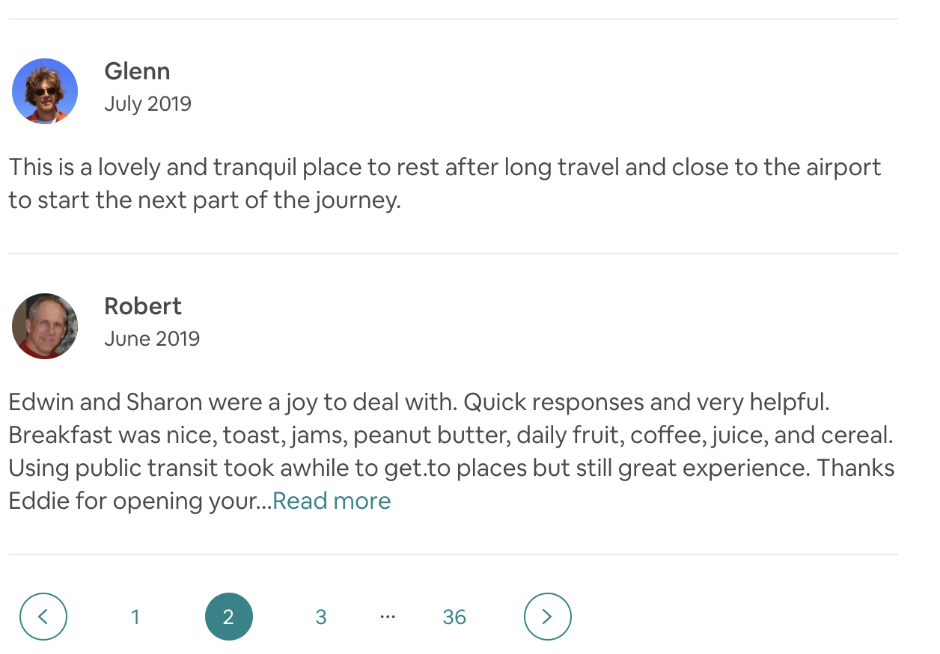
Current Airbnb reviews for 1 listing:

Slide 24
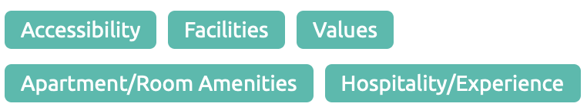
How will my topic modelling help:
Classifying all 246 reviews into the 5 Topics which LDA assigned into
Customer can choose to only read a compiled list of reviews of their interest

Slide 25

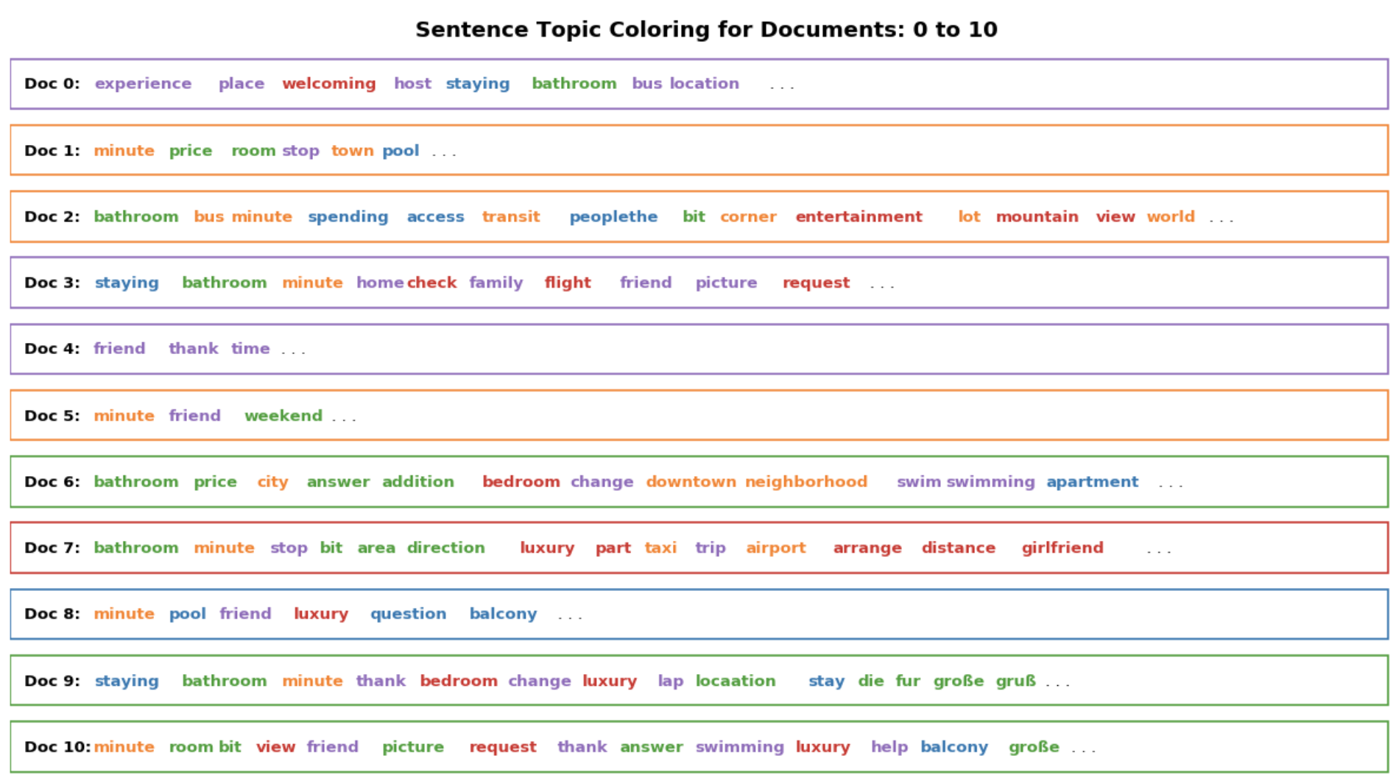
Topic classification for each reviews
Accessibility
Values
Hospitality /Experience
Facilities
Apartment/Room Amenities

Slide 26
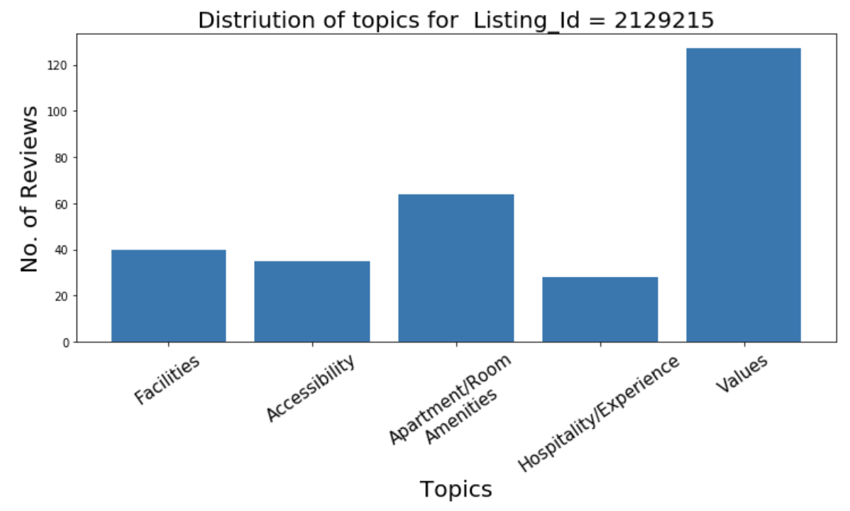
Case Study

